Slide 1
Umbrella tutorial
Preserving bertini software

Slide 2
Preparation

Slide 3
Executable file
wget http://bertini.nd.edu/BertiniLinux64_v1.5.tar.gz
tar -zxf BertiniLinux64_v1.5.tar.gz
cd BertiniLinux64_v1.5
tar -zcf bertini bertini.tar.gz

Slide 4
Input file
http://bertini.nd.edu/BertiniLinux64_v1.5.tar.gz
examples\pos_dim\basic_pos_dim\input

Slide 5
Creating umbrella spec
http://umbrella.basicuserinterface.com/creator/
Login: demo
Password: demo

Slide 6
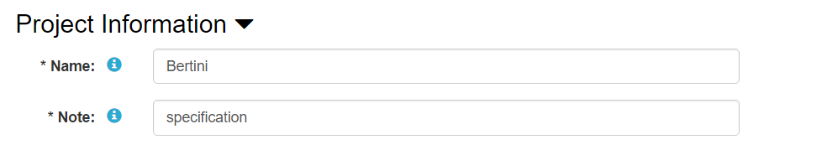
Step 1: Project information

Slide 7
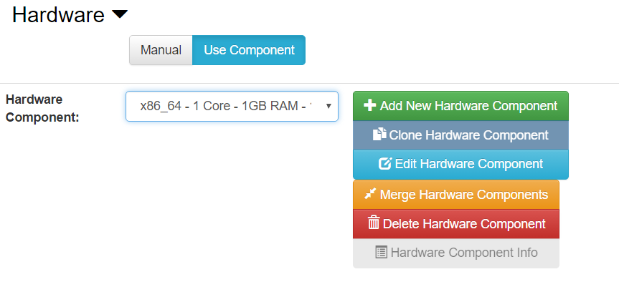
Step 2: Hardware

Slide 8
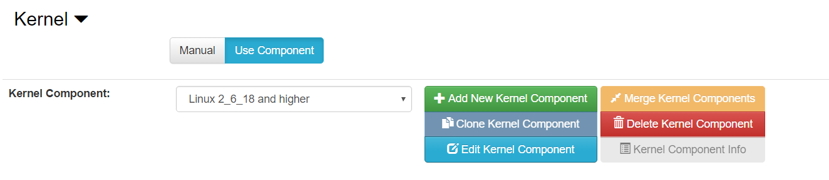
Step 3: Specify kernel

Slide 9
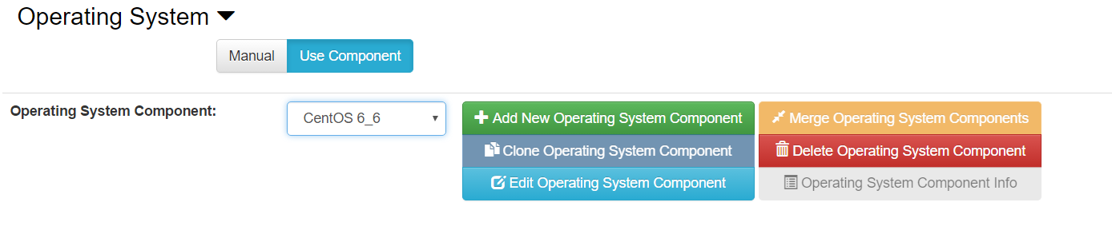
Step 4: Specify base OS image

Slide 10
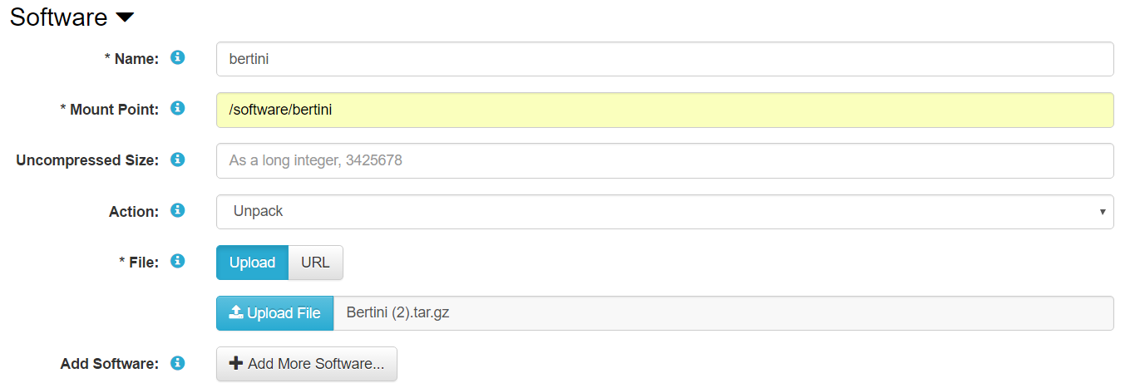
Step 5: Specify executable file(s)

Slide 11
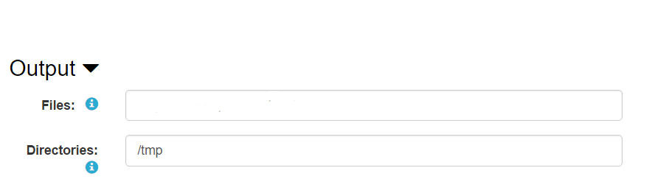
Step 6: Expected output

Slide 12
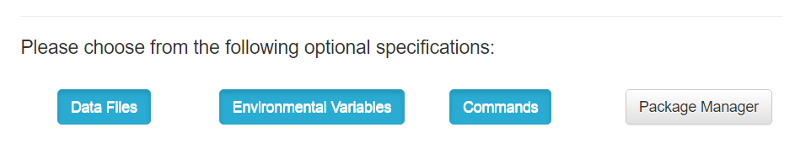
Step 7: Optional sections

Slide 13
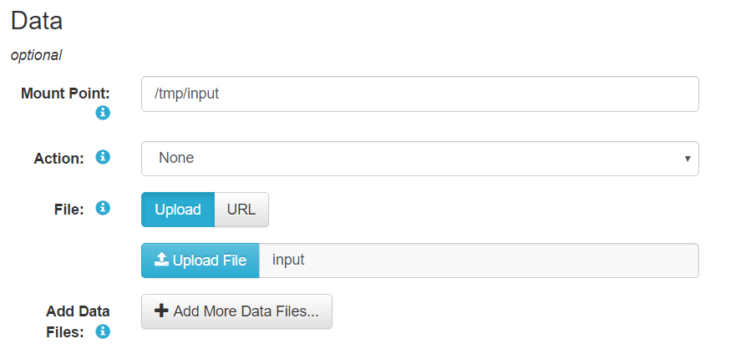
Step 8: Input file

Slide 14
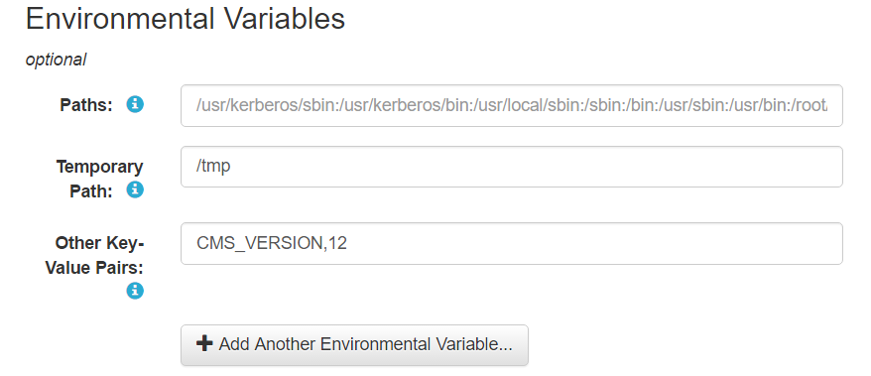
Step 9: Environment variables

Slide 15
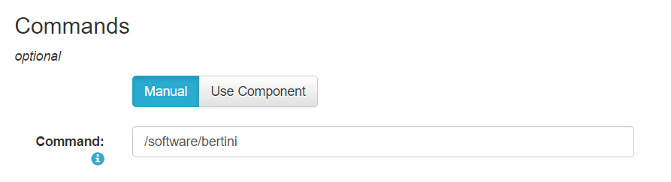
Step 10. Specify command to execute

Slide 16
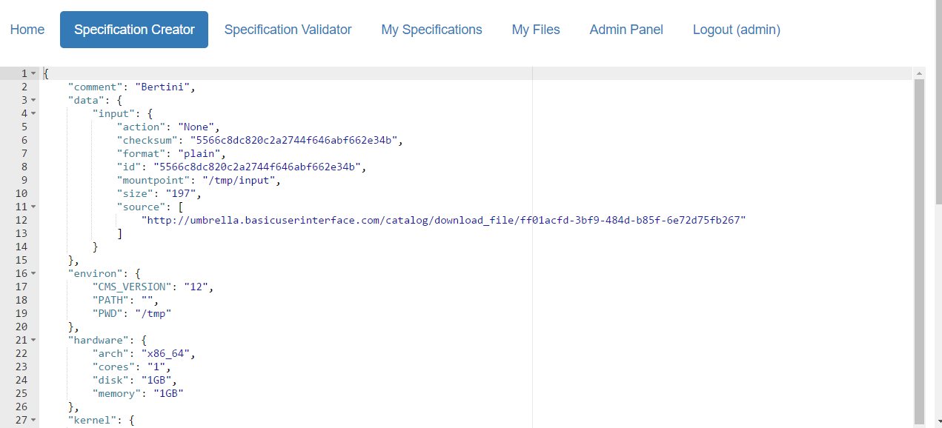
Example umbrella spec

Slide 17
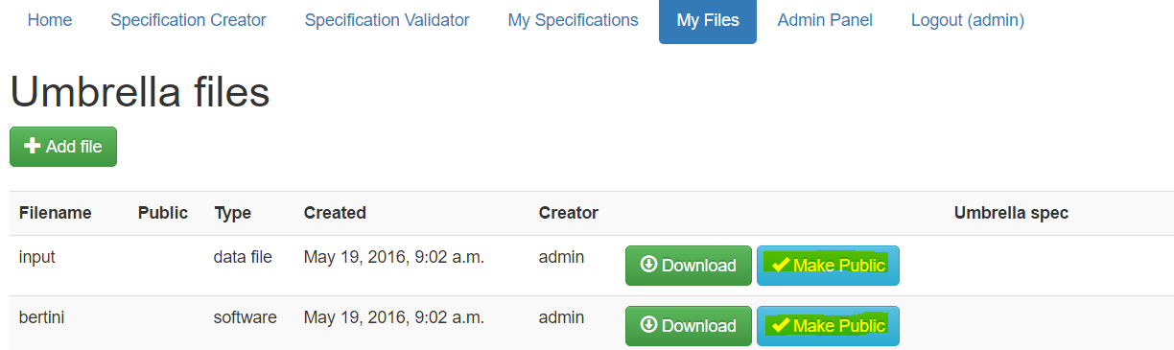
Step 11: Make files public

Slide 18
Run the specification

Slide 19
Step 1: Login to server
Umbrella and docker are installed and configured
Server: stockpile.crc.nd.edu
User: daspos
Password: daspos1

Slide 20
Step 2: Create a workspace directory
mkdir /tmp/alex

Slide 21
Step 3: Run the specification
sudo umbrella \
--spec bertini.umbrella \
--localdir /tmp/alex/umbrella_cache/ \
--output "/tmp=/tmp/alex/umbrella_cache/bertini_output" \
--sandbox_mode docker \
--log umbrella.log \
run

